Slide 1
Google Translate App
Group 12:
Eya Badal Abdisho
Neville Mascarenhas
Huy Van Vo
Mangesh Tak
CMPE 287
Guided By: Dr. Jerry Gao

Slide 2
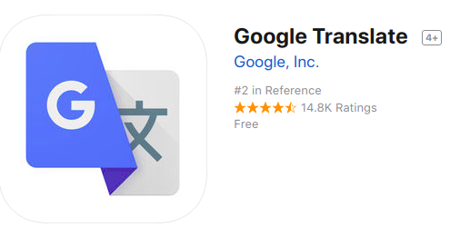
AI Mobile APP Overview

Slide 3
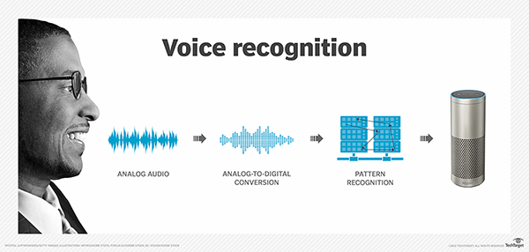
AI Feature:
Speech Recognition

Slide 4
Speech Recognition
The ability to recognize speech and perform actions base on it
In the context of app, the ability to convert voice to text
Deep learning finally made speech recognition accurate enough to be useful outside of carefully controlled environments

Slide 5
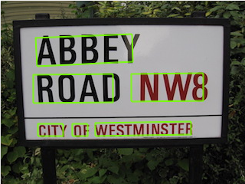
Image Recognition

Slide 6
Image Recognition
The ability to understand images
In the context of app, the ability to convert text via images to text
Recent advances in deep learning made tasks such as mage recognition possible
Google is leading the change

Slide 7
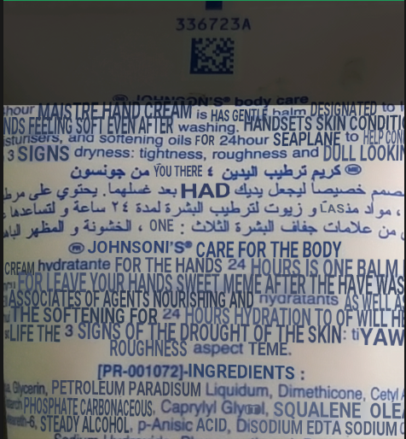
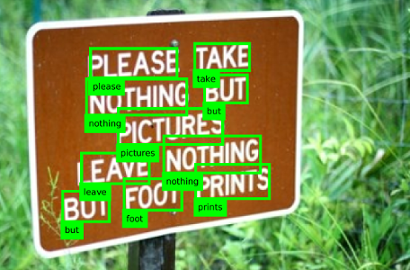
Image Recognition
Image input by smartphone camera
Can be street signs, human handwriting, etc.
Draw text right on smartphone screen!

Slide 8
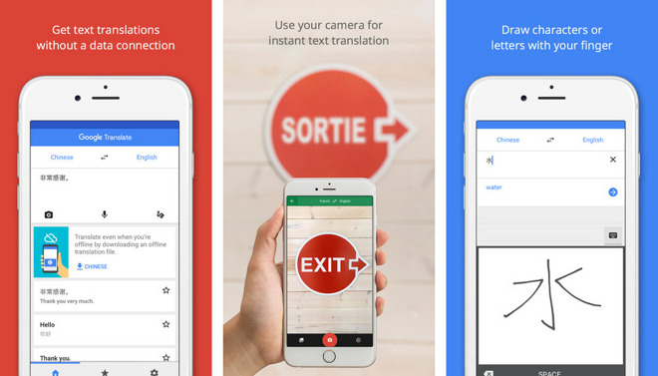
Language Translation

Slide 9
Language Translation
The ability to convert language A to language B
Google Translate as of today supports 88 languages
Google uses a neural machine translation engine that translates text as a whole sentences at a time, rather than just piece by piece

Slide 10
Human Language
Social tools
Has rules and meanings. Guide how parts of language can be combined
Human language is arbitrary
Grammar rules
Tough for computer!

Slide 11
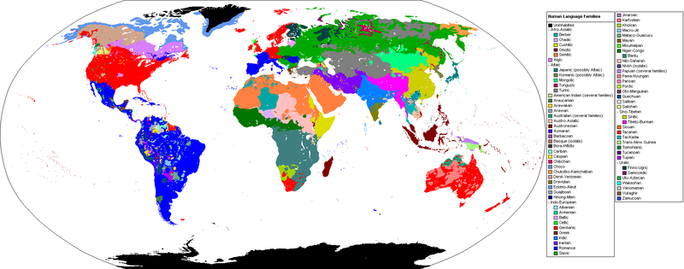
Collections of languages

Slide 12
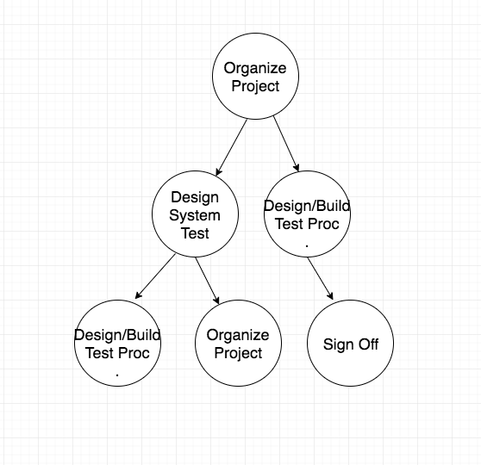
Our Testing Process

Slide 13
Test model
The tree groups similar languages together
Using test model, we get a generalized view of all the possible inputs parameters to test the application against.
This tree based model allows test engineers and QA managers to ensure complete coverage of the test cases for given input use cases.

Slide 14
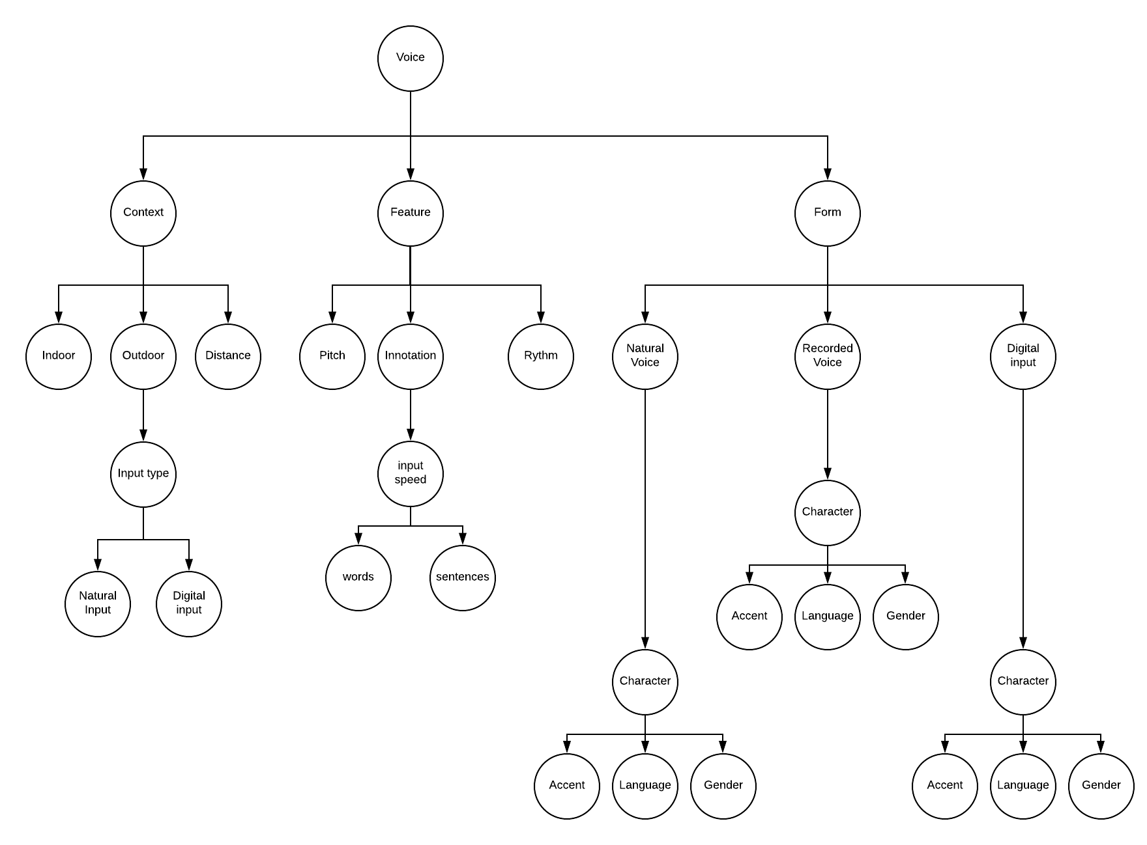
Test Model - AI Based Tree - Voice

Slide 15
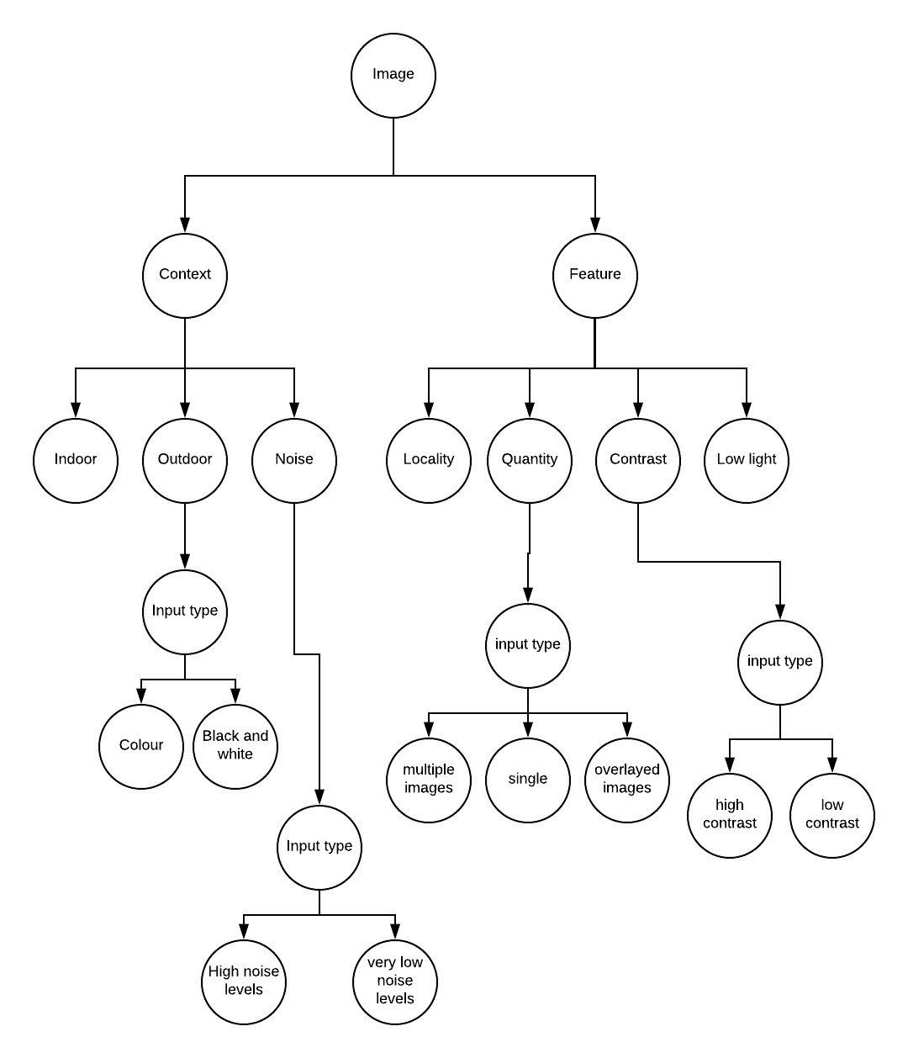
Test Model - AI Based Tree - Image

Slide 16
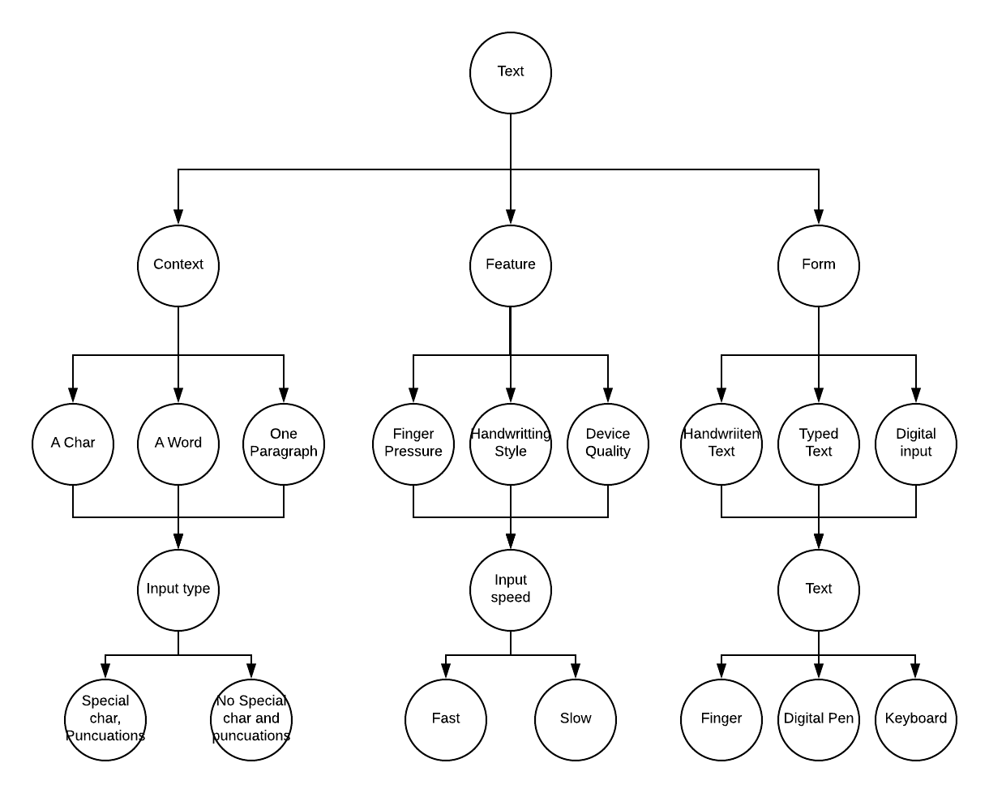
Test Model - AI Based Tree - Text

Slide 17
Testing method
Boundary Value Analysis
State Transition Diagrams
Category Partitioning

Slide 18
Coverage and Results
Photo
Speech
Hand written text and Typed text

Slide 19
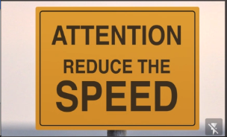
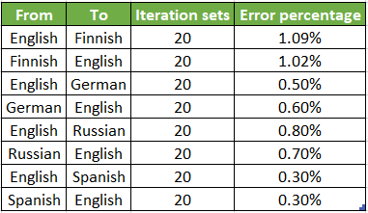
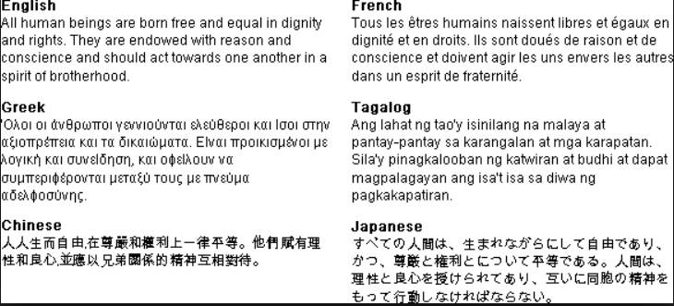
Photo Result - AI Testing Statistics
References:
http://statmt.org/wmt18/index.html

Slide 20
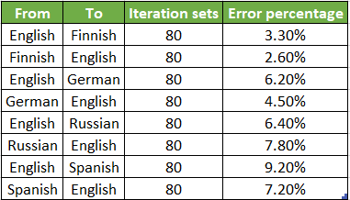
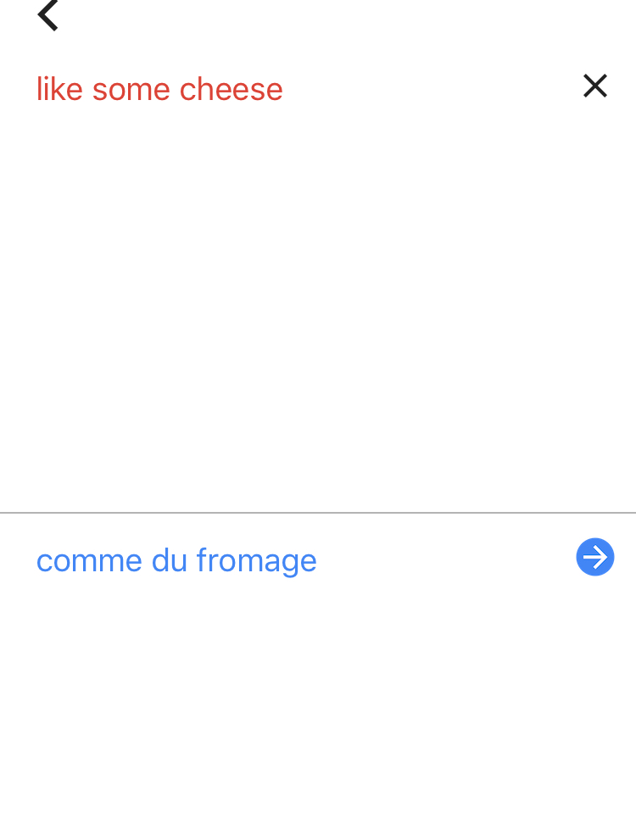
Speech Result - AI Testing Statistics

Slide 21
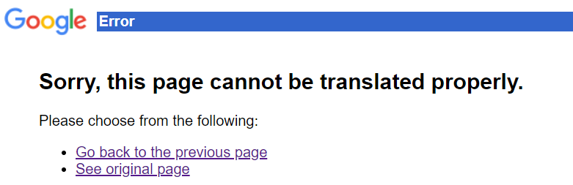
AI Bugs/Errors
Inability to recognize voice at times
Inability to translate blurred images
Inability to recognize human handwriting

Slide 22
Experiences
Testing AI based mobile application is not a discrete process
Since the application is a COTs product; we did not have access to the learning models being used by the app that made it impossible to perform any white-box tests.
Finding the variety of image inputs to ensure full coverage was time consuming as it is impossible to come up with all possible image inputs.
Testing multiple sets of languages made the verification process difficult as we have limited native language speakers for the particular language being tested.

